Slide 1
Predicting Housing Prices For King County
Authors: Vikrant Deshpande, Tanvi Kolhatkar, Saishree Godbole
INDIANA UNIVERSITY

Slide 2
Introduction

Slide 3
Introduction
Accurately predicting the house prices of any housing development is always a major problem in the world today and especially in a highly populated city like Seattle. The ever-fluctuating prices got us interested in what features would play the biggest part in predicting house prices.
To study this, we are exploring a dataset of home selling-prices in King County, Washington.
We are building a multiple regression model with the house price variable as the target variable and selected features as the explanatory variables. The questions we aim to answer are:
Check which features affect the house prices
Investigate if features such as location apart from our selected features affect the house prices.
Identify if the home-price can be explained by a linear relationship with the chosen features or is a more complex model required

Slide 4
Data Description

Slide 5
Data Description
Features | Description
id | Unique ID for each home sold
date | Date of the home sale (between 2014 to 2015)
price | Price of each home sold
bedrooms | Number of bedrooms
bathrooms | Number of bathrooms, where 0.5 accounts for a room with a toilet but no shower
sqft_living | Square footage of the apartment’s interior living space
sqft_lot | Square footage of the land space
floors | Number of floors
waterfront | A dummy variable for whether the apartment was overlooking the waterfront or not
view | An index from 0 to 4 of how good the view of the property was
Our dataset contains house sale prices for King County, Washington between May 2014 and May 2015.
The dataset includes information on 21,613 homes.
Along with the house prices data, it contains the date and ID of sale and 18 descriptive features.

Slide 6
Data Description
Features | Description
condition | An index from 1 to 5 on the condition of the apartment,
grade | An index from 1 to 13, where 1 – 3 falls short of building construction and design, 7 has an average level of construction and design, and 11 - 13 have a high-quality level of construction and design.
sqft_above | The square footage of the interior housing space that is above ground level
sqft_basement | The square footage of the interior housing space that is below ground level
yr_built | The year the house was initially built
yr_renovated | The year of the house’s last renovation
zipcode | What zip code area the house is in
lat | Latitude
long | Longitude
sqft_living15 | The square footage of interior housing living space for the nearest 15 neighbors
sqft_lot15 | The square footage of the land lots of the nearest 15 neighbors

Slide 7
Data Cleaning and Transformation

Slide 8
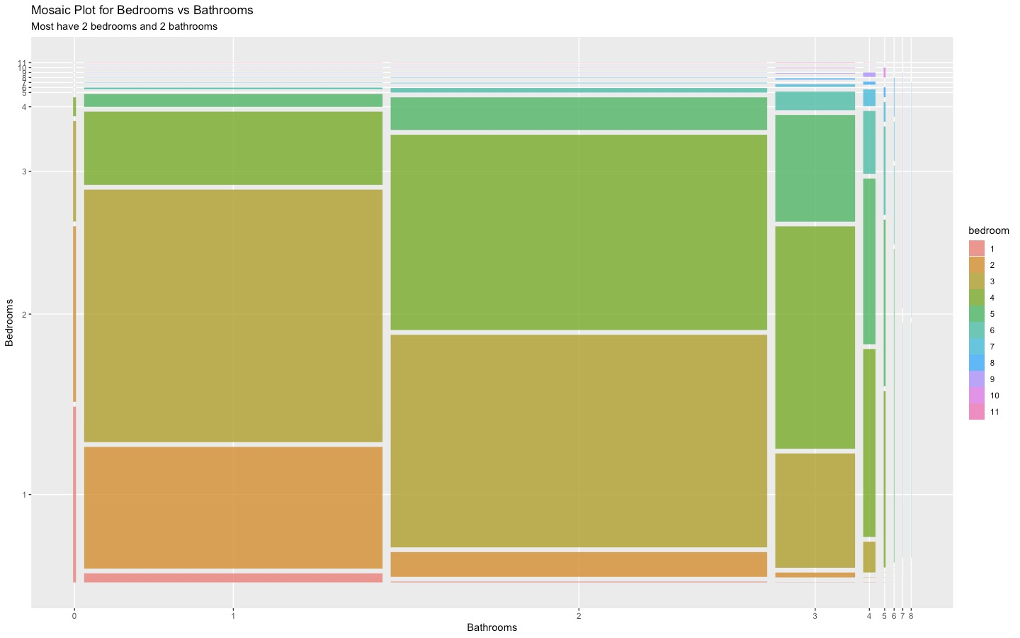
Data Cleaning and Transformations
While going through the dataset we observed a few discrepancies that had to be corrected:
Removed erroneous data
Records with 33 bedrooms in a living area of 1620 sqft.
Records of houses with no bedrooms and bathrooms

Slide 9
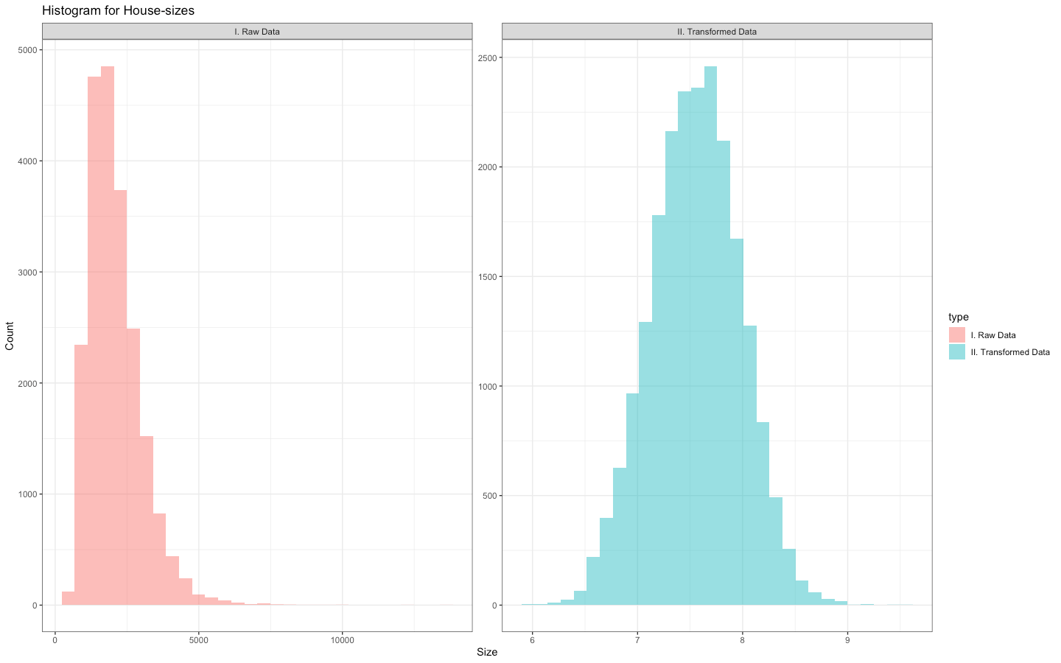
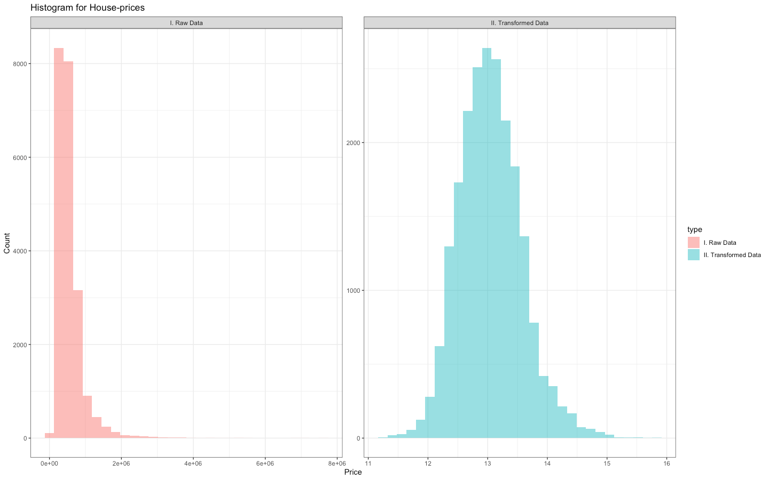
2. Performed log transformations on highly right skewed data
Sqft living
House price

Slide 10
Feature Selection
ANALYSIS

Slide 11
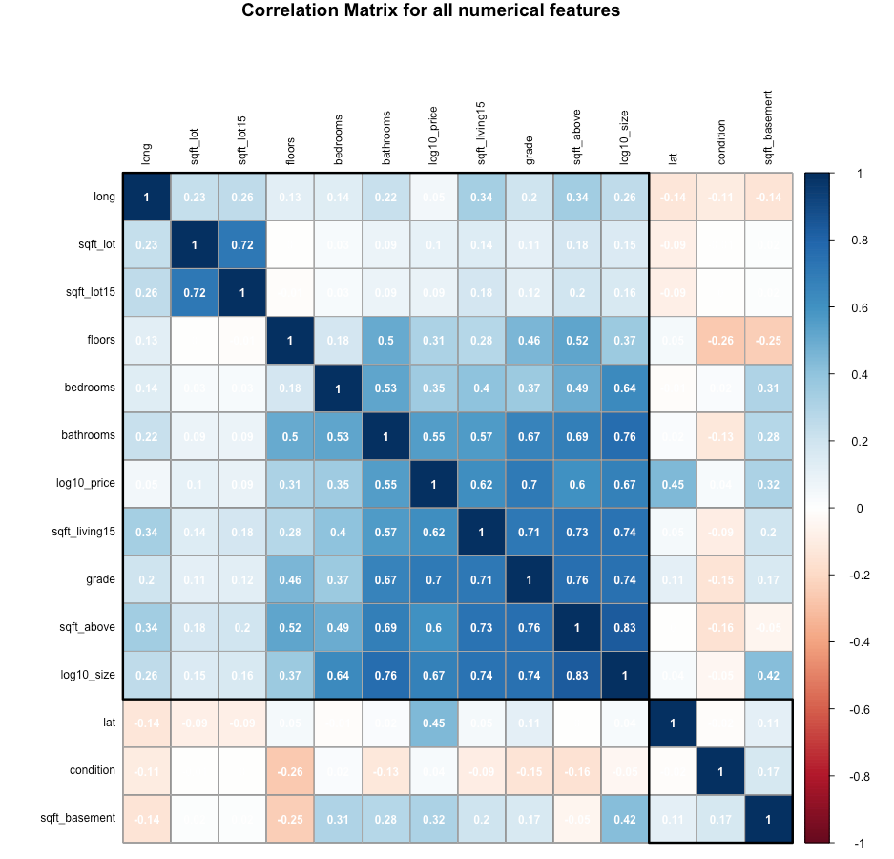
Feature Selection
We selected the numerical variables from the heatmap as they have high correlation with the target variable price.
We excluded the variable sqft_living_15 which has high correlation with the target variable house price as well as the independent variable sqft_living to avoid multicollinearity.

Slide 12
Feature Selection
For the variables ‘bathroom’, ‘bedroom’ and ‘grade’ we plotted the square footage of the property vs the price faceted by each variable. We can see a change in the slopes of the regression lines as the variable changes. This alludes to an interaction between the variables and the property price.
On the other hand, the slope of the regression lines for variable ‘condition’ did not have any big changes.
Based on our findings, the features ‘sqft_living’, ‘bathrooms’, ‘bedrooms’ and ’grade’ are great candidates to predict house prices in King County, Seattle.

Slide 13
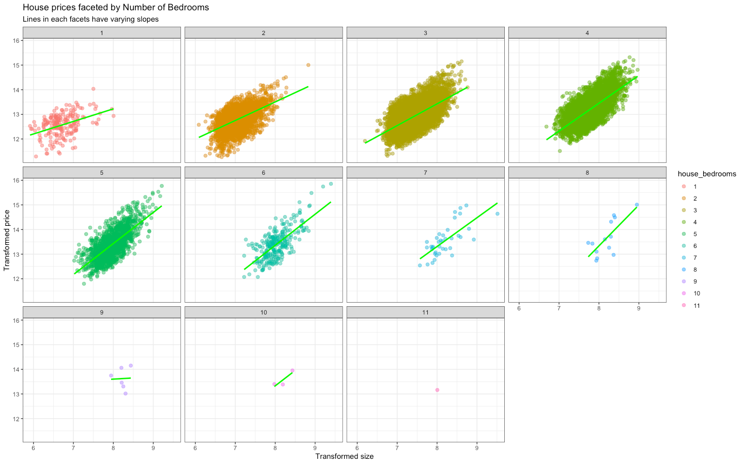

Slide 14
Additional factors - Location
ANALYSIS

Slide 15
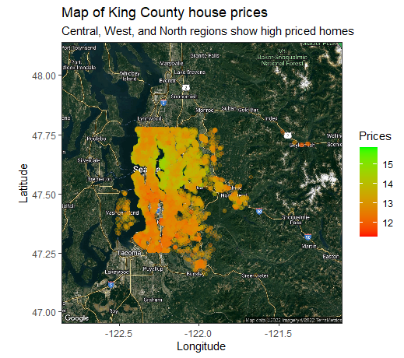
Investigate if location affects the house prices
In housing development, the prices vary based on geographical features such as the the neighborhood (rich or poor) of the house or the view (waterfront, coastwide). We tested this hypothesis for King County.
The prices increase slightly as we move from the South to the North Seattle but not much variation across longitude.
Thus, we will be exploring the latitude feature in our model but not the longitude feature.

Slide 16
Fitting a linear model
ANALYSIS

Slide 17
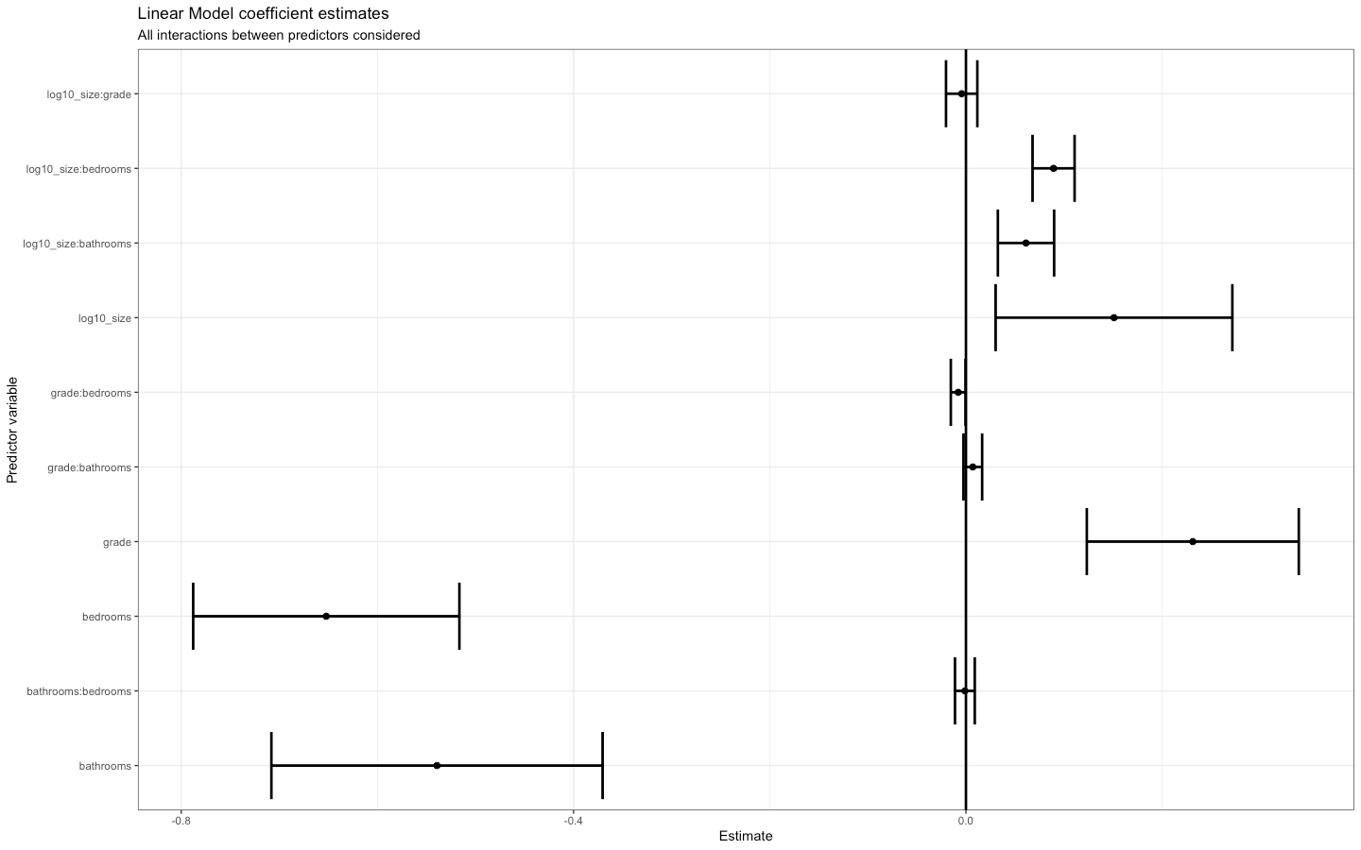

Slide 18
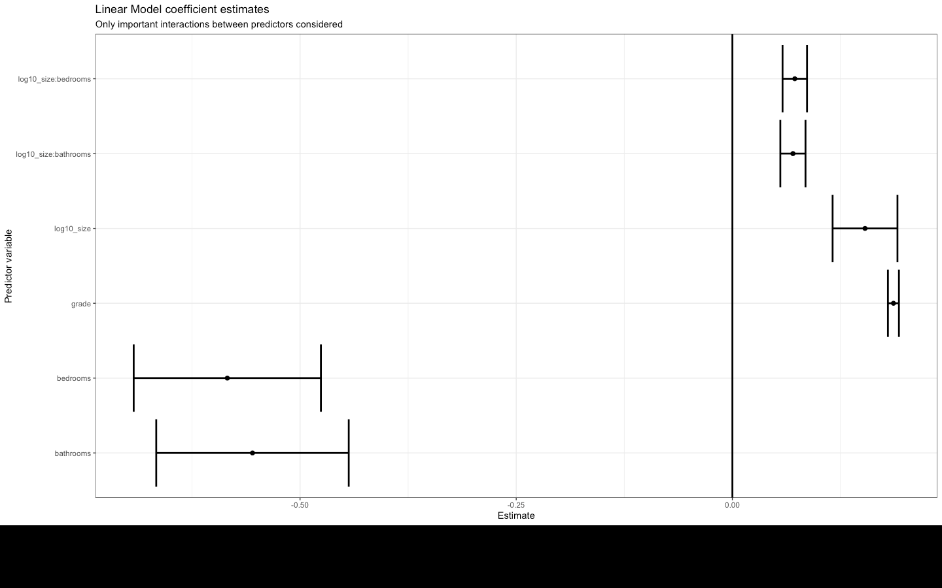

Slide 19
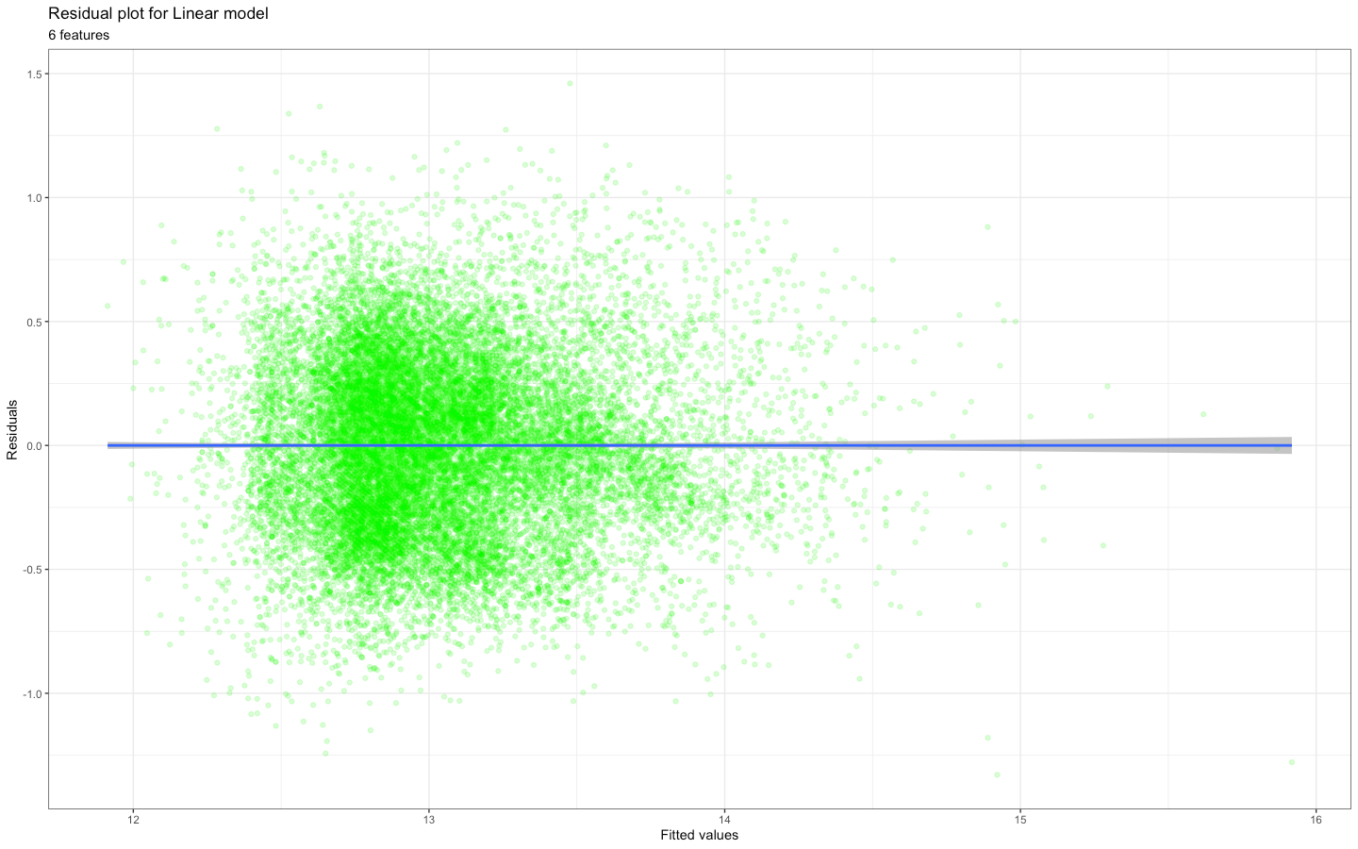
The residuals plot shows homoscedasticity

Slide 20
Results, Limitations and Next Steps
CONCLUSION

Slide 21
Results and Limitations
The features that had the most effect on the house price are sqft_living, bedrooms, bathrooms, grade.
We will investigate the latitude feature as we see a slight increase in the prices from South to the North Seattle.
The relationship between the house price and the features can be explained by a linear model.
The dataset holds house prices only for the years 2014 and 2015. This limits us in commenting on the importance of the variable in predicting house prices over time.

Slide 22
Next Steps
As of now, we have fit our data with a linear model. Over the next few days, we plan to explore more complex models like LOESS to find the model that fits the best.
We also plan to transform and add other features like the latitude, longitude etc. to check if there are any features that should be included in our final model.

Slide 23
Thank You! ☺

Slide 24
